Slide 1
DS-670 Assignment 4:
Competitor Article Presentation
By Mohamed Mohamar

Slide 2
Article selection
I selected the 8th article from my State of the Art assignment.
Title: Single-hidden layer neural networks for forecasting intermittent demand.
By: F. Lollia, R. Gamberinia, A. Regattierib, E. Balugania, T. Gatosb, S. Guccib. International Journal of Production Economics. Volume 183, Part A, January 2017, Pages 116–128.

Slide 3
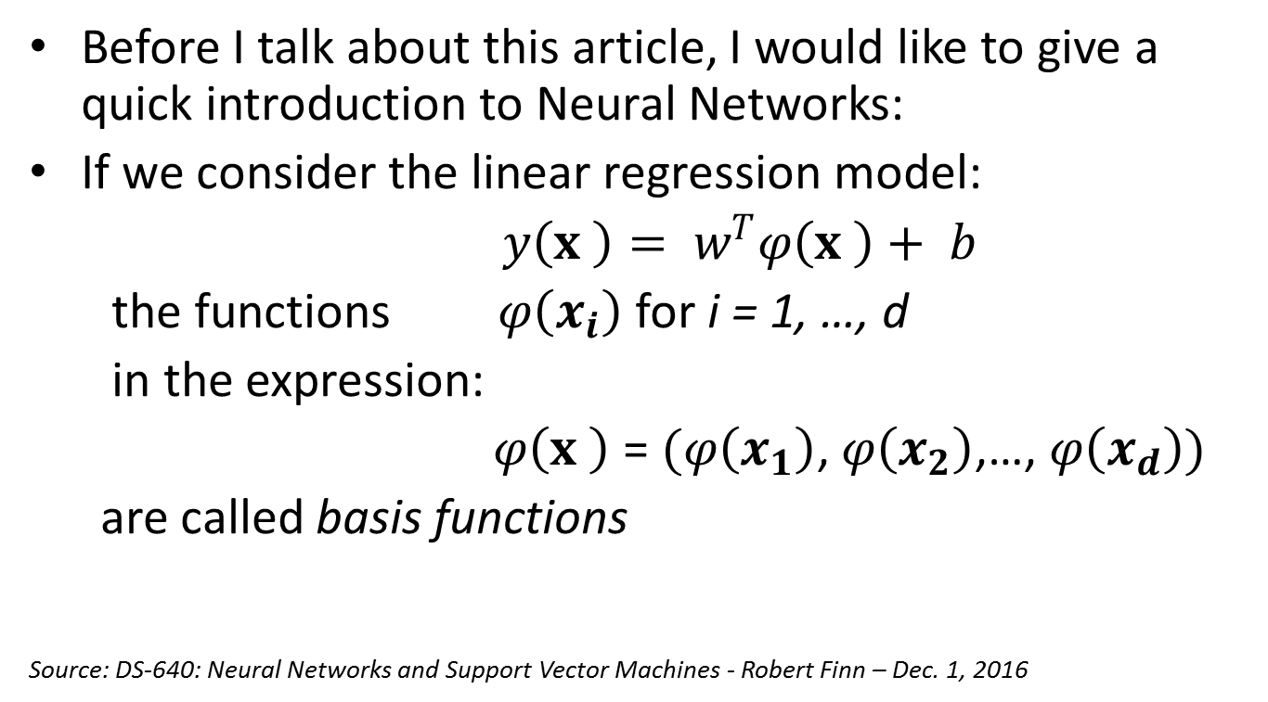
Introduction to Neural networks
Before I talk about this article, I would like to give a quick introduction to Neural Networks:
If we consider the linear regression model:
$y\left(x \right)= w^{T}φ\left(x \right)+ b$
the functions $φ\left(x_{i}\right)$ for i = 1, …, d
in the expression:
$φ\left(x \right)$ = $(φ\left(x_{1}\right)$, $φ\left(x_{2}\right)$,…, $φ\left(x_{d}\right))$
are called basis functions
Source: DS-640: Neural Networks and Support Vector Machines - Robert Finn – Dec. 1, 2016

Slide 4
Introduction to Neural networks
Instead of linear regression, let’s allow the functions of the independent variables, or basis functions, to be adaptive.
Meaning that we use parametric forms for the basis functions in which the parameter values are adapted during training.
A very successful model of this type is the feed-forward neural network, also known as the multilayer perceptron, which is based on the perceptron algorithm.
Source: DS-640: Neural Networks and Support Vector Machines - Robert Finn – Dec. 1, 2016

Slide 5
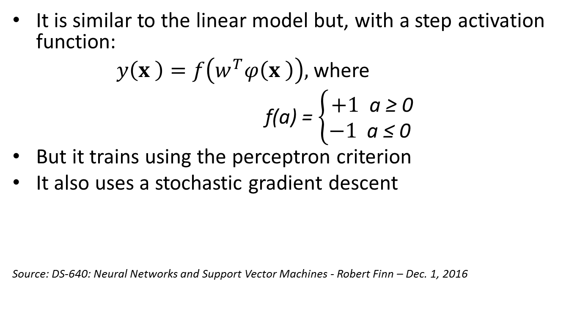
Introduction to Neural networks
It is similar to the linear model but, with a step activation function:
$y\left(x \right)=f\left(w^{T}φ\left(x \right)\right),$where
f(a) = $\left\{\begin{aligned}+1 \text{a}\text{ ≥ 0} \\ −1 \text{a}\text{ ≤ 0 }\end{aligned}\right.$
But it trains using the perceptron criterion
It also uses a stochastic gradient descent
Source: DS-640: Neural Networks and Support Vector Machines - Robert Finn – Dec. 1, 2016

Slide 6
Introduction to Neural networks
Perceptron convergence theorem: If there exists an exact solution, i.e. if the training set is indeed linearly separable, then the Perceptron Algorithm will find a solution in finite number of steps.
Source: DS-640: Neural Networks and Support Vector Machines - Robert Finn – Dec. 1, 2016

Slide 7
Introduction to Neural networks
For many applications, neural networks can be significantly more compact and faster to evaluate than a support vector machine.
But at a certain price: the likelihood function, which forms the basis for network training, is no longer a convex function of the model parameters.
In practice, however, it is often worth investing substantial computational resources during the training phase in order to obtain a compact model that is fast at processing new data
Source: DS-640: Neural Networks and Support Vector Machines - Robert Finn – Dec. 1, 2016

Slide 8
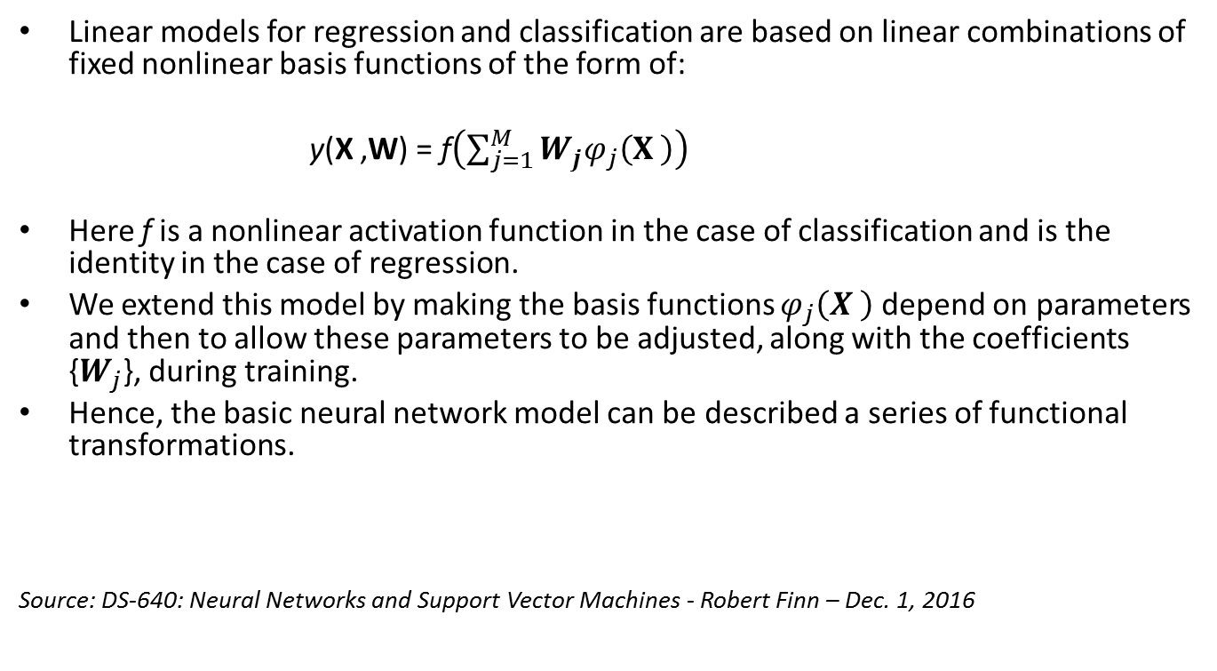
Introduction to Neural networks
Linear models for regression and classification are based on linear combinations of fixed nonlinear basis functions of the form of:
y(X ,W) = f$\left(\sum_{j=1}^{M}{W_{j}φ_{j}\left(X \right)}\right)$
Here f is a nonlinear activation function in the case of classification and is the identity in the case of regression.
We extend this model by making the basis functions $φ_{j}\left(X \right)$ depend on parameters and then to allow these parameters to be adjusted, along with the coefficients {$W_{j}$}, during training.
Hence, the basic neural network model can be described a series of functional transformations.
Source: DS-640: Neural Networks and Support Vector Machines - Robert Finn – Dec. 1, 2016

Slide 9
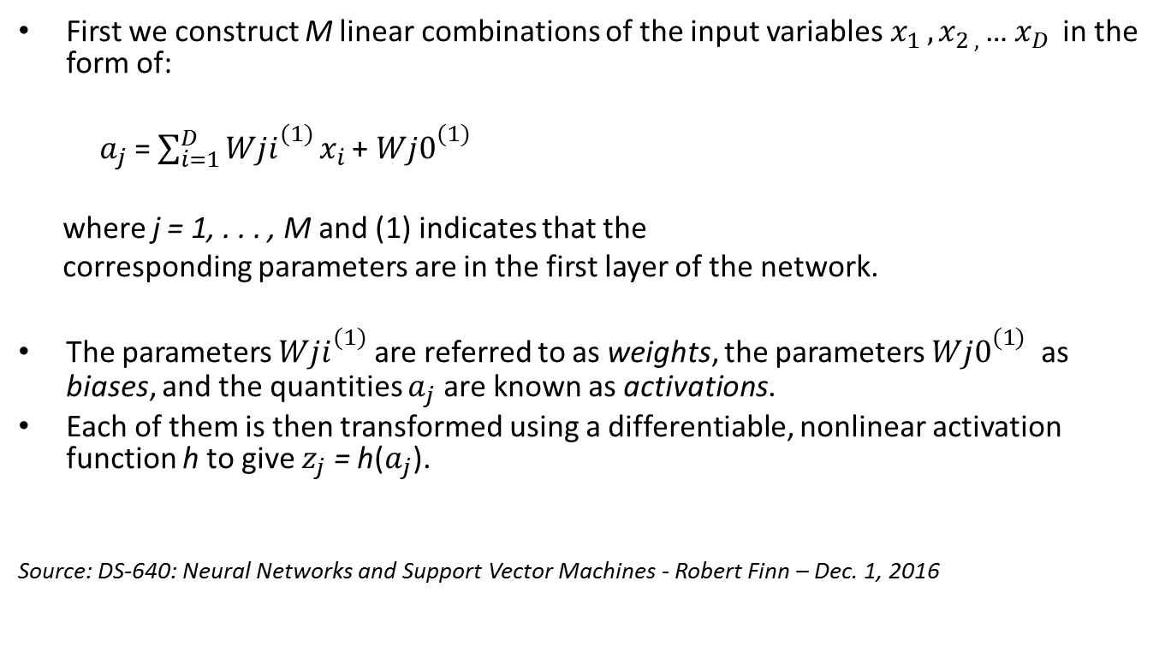
Introduction to Neural networks
First we construct M linear combinations of the input variables $x_{1 },x_{2 , }$… $x_{D }$in the form of:
$a_{j}$ = $\sum_{i=1}^{D}{{Wji}_{}^{(1)}}x_{i }$+ ${Wj0}_{}^{(1)}$
where j = 1, . . . , M and (1) indicates that the
corresponding parameters are in the first layer of the network.
The parameters ${Wji}_{}^{(1)}$ are referred to as weights, the parameters ${Wj0}_{}^{(1)}$ as biases, and the quantities $a_{j}$ are known as activations.
Each of them is then transformed using a differentiable, nonlinear activation function h to give $z_{j}$ = h($a_{j}$).
Source: DS-640: Neural Networks and Support Vector Machines - Robert Finn – Dec. 1, 2016

Slide 10
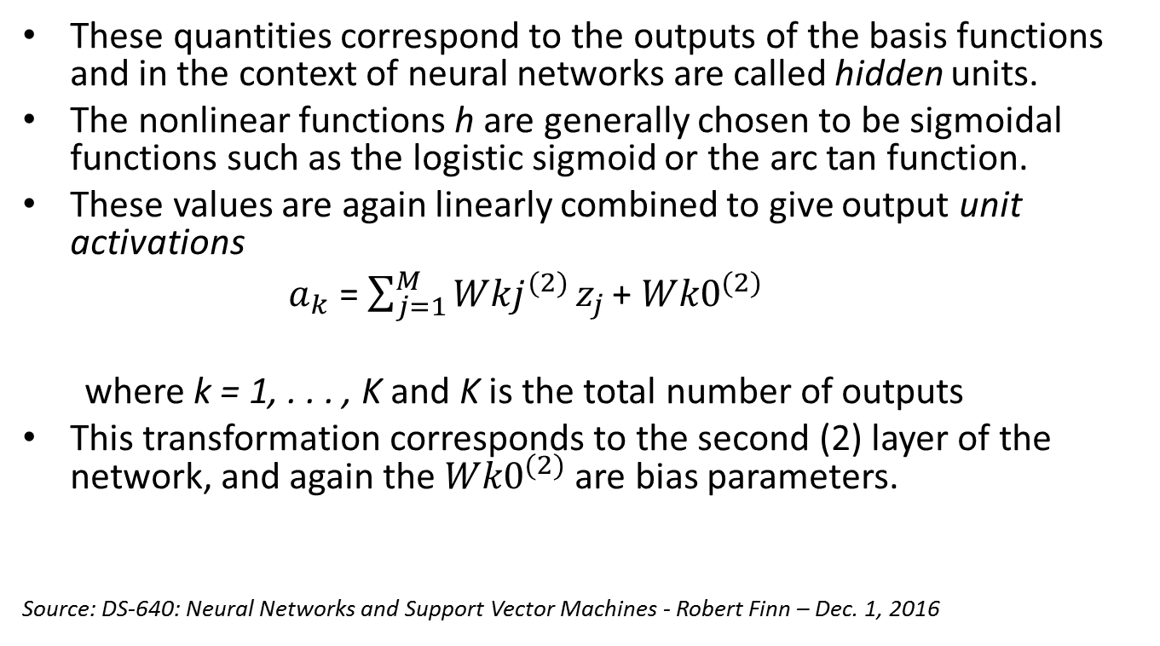
Introduction to Neural networks
These quantities correspond to the outputs of the basis functions and in the context of neural networks are called hidden units.
The nonlinear functions h are generally chosen to be sigmoidal functions such as the logistic sigmoid or the arc tan function.
These values are again linearly combined to give output unit activations
$a_{k}$ = $\sum_{j=1}^{M}{{Wkj}_{}^{(2)}}z_{j }$+ ${Wk0}_{}^{(2)}$
where k = 1, . . . , K and K is the total number of outputs
This transformation corresponds to the second (2) layer of the network, and again the ${Wk0}_{}^{(2)}$are bias parameters.
Source: DS-640: Neural Networks and Support Vector Machines - Robert Finn – Dec. 1, 2016

Slide 11
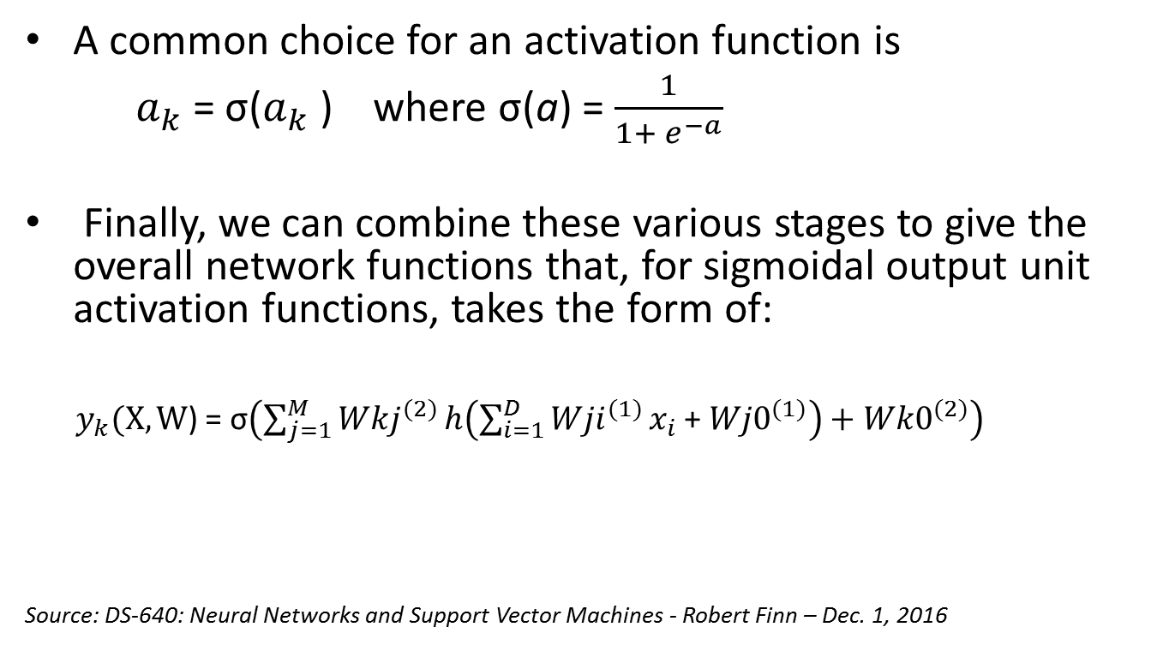
Introduction to Neural networks
A common choice for an activation function is
$a_{k}$ = σ($a_{k}$ ) where σ(a) = $\frac{1}{1+ e^{−a}}$
Finally, we can combine these various stages to give the overall network functions that, for sigmoidal output unit activation functions, takes the form of:
$y_{k}(X,W$) = σ$\left(\sum_{j=1}^{M}{{Wkj}_{}^{(2)}}h\left(\sum_{i=1}^{D}{{Wji}_{}^{(1)}}x_{i }\text{+ }{Wj0}_{}^{(1)}\right)+{Wk0}_{}^{(2)}\right)$
Source: DS-640: Neural Networks and Support Vector Machines - Robert Finn – Dec. 1, 2016

Slide 12
Single-hidden layer neural networks for forecasting intermittent demand
In this article, the authors are proposing a method that uses a single-hidden layer feedforward neural network for forecasting intermittent demand.
Which is based on the back-propagation gradient-descent, perceptron algorithm described earlier in the introduction to Neural Networks.

Slide 13
Single-hidden layer neural networks for forecasting intermittent demand
However, due to some of the drawbacks of back-propagation gradient descent algorithms including, slow convergence, setting learning parameters, etc.
They are relying on a “faster learning algorithm”, first introduced by Huang et al. (2006), later reviewed by the same authors Huang et al. (2015)

Slide 14
Single-hidden layer neural networks for forecasting intermittent demand
Their proposal aims to “ helping the network to learn the temporal behavior of the time series in terms of zero/non-zero demand” (Lollia et al. 2017)
They compared the accuracy of their forecasting model with other Neural Networks that dealt with intermittent demands (Guttierez et al., 2008; Mukhopadhyay et al. 2012; Croston, 1972; Syntetos and Boylan, 2005)

Slide 15
Single-hidden layer neural networks for forecasting intermittent demand
As conclusion, the authors argue that “this comparison was then enriched by adopting two different accuracy metrics on different time horizons. Such a detailed comparison aims at bridging the gap between theory and practice of ANNs in the field of intermittent demand.” (Lollia et al. 2017)
“In fact, the potential for implementation of ANNs in real environments can only increase by providing useful guidelines about their design and training for practitioners. Finally, a statistical analysis of the networks’ performance was conducted, for robust validation of the results.” (Lollia et al. 2017)

Slide 16
My Project
The R neuralnet package that I am using is based on the same back-propagation gradient descent algorithm.
However, I am utilizing a double-hidden layer neural network for training instead of a single-hidden layer used by the authors of the article discussed above.

Slide 17
My Project
My idea is to use linear regression and neural network time series analysis to build a model to predict and forecast stock market volatility
My goal is ultimately to build a high performant stock market analysis compact model that can be used as an investment tool.
Although their single-hidden layer NN model might converge faster, I believe my model will outperform theirs because I and using a double-hidden layer Neural Network.

Slide 18
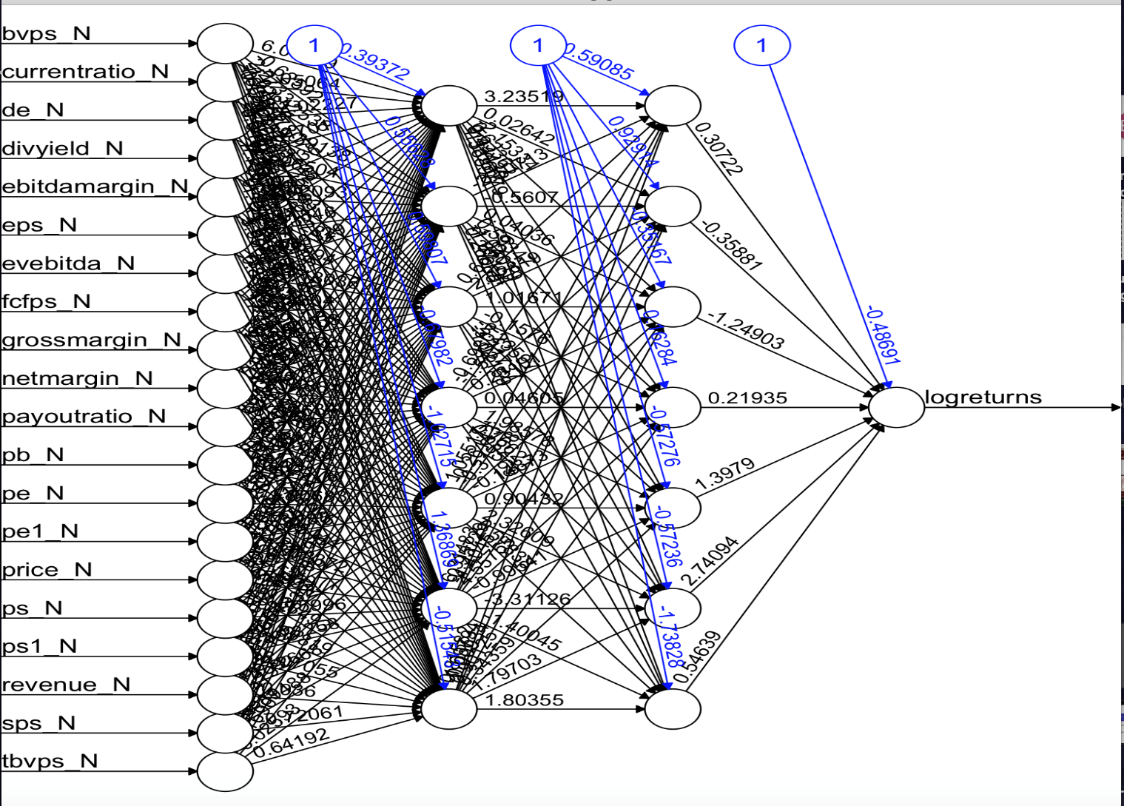
Double-hidden layer NN
Double-hidden layer NN
Notes:
Graph generated in Rstudio. nn.model_2011_03_31

Slide 19
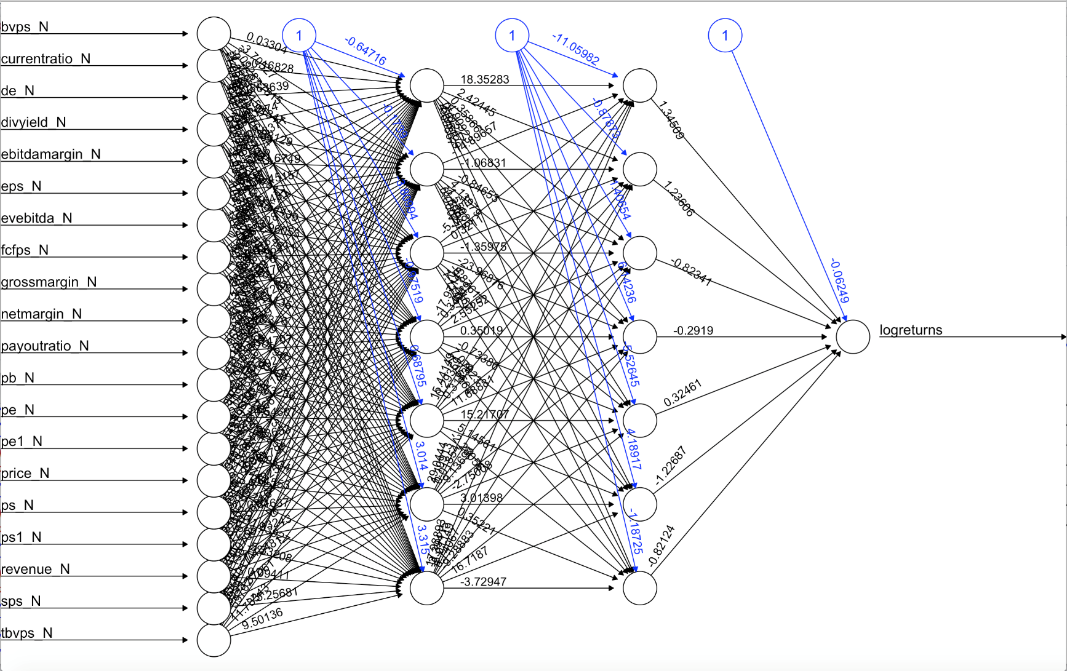
Double-hidden layer NN
Notes:
Graph generated in Rstudio. nn.model_2011_06_30

Slide 20
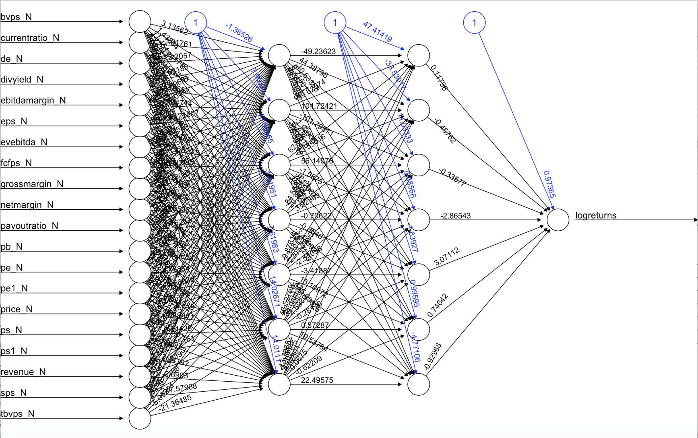
Double-hidden layer NN
Notes:
Graph generated in Rstudio. nn.model_2011_09_30

Slide 21
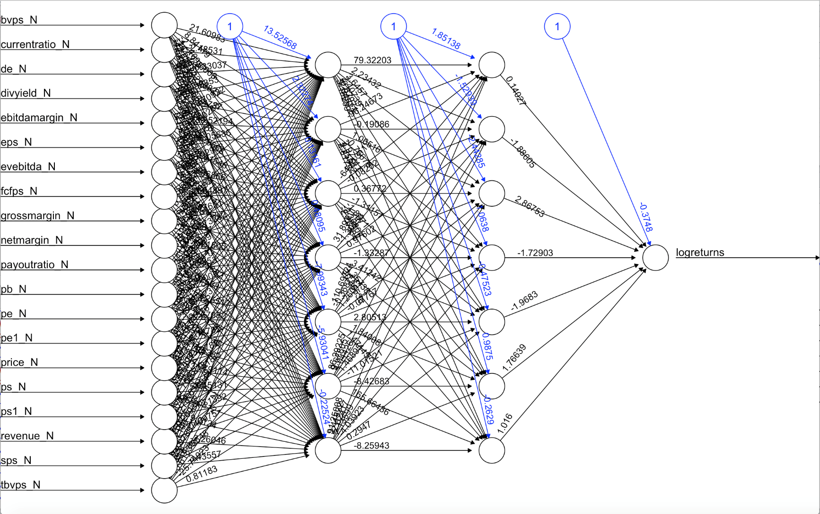
Double-hidden layer NN
Notes:
Graph generated in Rstudio. nn.model_2012_03_31

Slide 22
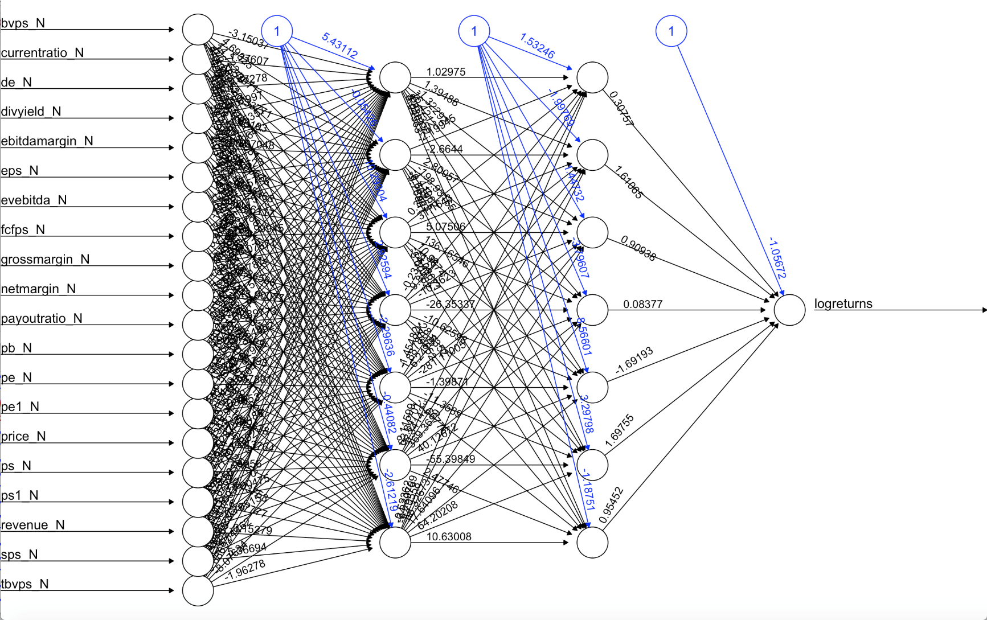
Double-hidden layer NN
Notes:
Graph generated in Rstudio. nn.model_2014_06_30nn.model_2014_06_30

